Slide 1

CSE- 208
Algorithms Lab
Lab: 07
Greedy Approach
Fahad Ahmed
Lecturer, Dept. of CSE
E-mail: fahadahmed@uap-bd.edu

Slide 2
Task-07
Problem:
Implement the following algorithm using Greedy Approach:
Fractional Knapsack Problem
Coin Changing Problem

Slide 3


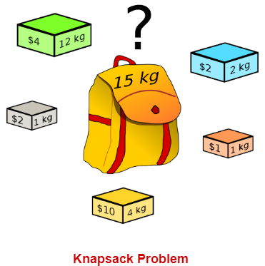
Fractional Knapsack Problem

Slide 4
The Fractional Knapsack Problem
Given: A set S of n items, with each item i having
b_{i} - a positive benefit
w_{i} - a positive weight
Goal: Choose items with maximum total benefit but with weight at most W.
If we are allowed to take fractional amounts, then this is the fractional knapsack problem.
In this case, we let x_{i} denote the amount we take of item i
Objective: maximize
Constraint:

Slide 5
Greedy Algorithm for Fractional Knapsack problem
Fractional knapsack problem is solved using greedy method in the following steps-
Step-01:
For each item, compute its value / weight ratio.
Step-02:
Arrange all the items in decreasing order of their value / weight ratio.
Step-03:
Start putting the items into the knapsack beginning from the item with the highest ratio.
Put as many items as you can into the knapsack.

Slide 6
Example
A thief enters a house for robbing it. He can carry a maximal weight of 60 kg into his bag. There are 5 items in the house with the following weights and values.
What items should thief take if he can even take the fraction of any item with him?
Item | Weight | Value
1 | 5 | 30
2 | 10 | 40
3 | 15 | 45
4 | 22 | 77
5 | 25 | 90

Slide 7
Example
Step-01:
Compute the value / weight ratio for each item-
Items | Weight | Value | Ratio
1 | 5 | 30 | 6
2 | 10 | 40 | 4
3 | 15 | 45 | 3
4 | 22 | 77 | 3.5
5 | 25 | 90 | 3.6
Step-02:
Sort all the items in decreasing order of their value / weight ratio-
I-1 I-2 I-5 I-4 I-3
(6) (4) (3.6) (3.5) (3)

Slide 8
Example
Start filling the knapsack by putting the items into it one by one.
Knapsack Weight | Items in Knapsack | Total profit
60 | Ø | 0
55 | I-1 | 30
45 | I-1, I-2 | 70
20 | I-1, I-2, I-5 | 160
Now,
Knapsack weight left to be filled is 20 kg but item-4 has a weight of 22 kg.
Since in fractional knapsack problem, even the fraction of any item can be taken.
So, knapsack will contain the following items-
< I-1 , I-2 , I-5 , (20/22) I4 >
Total Profit of the knapsack
= 160 + (20/22) x 77
= 160 + 70
= 230 units
Items | Weight | Value | Ratio
1 | 5 | 30 | 6
2 | 10 | 40 | 4
3 | 15 | 45 | 3
4 | 22 | 77 | 3.5
5 | 25 | 90 | 3.6

Slide 9
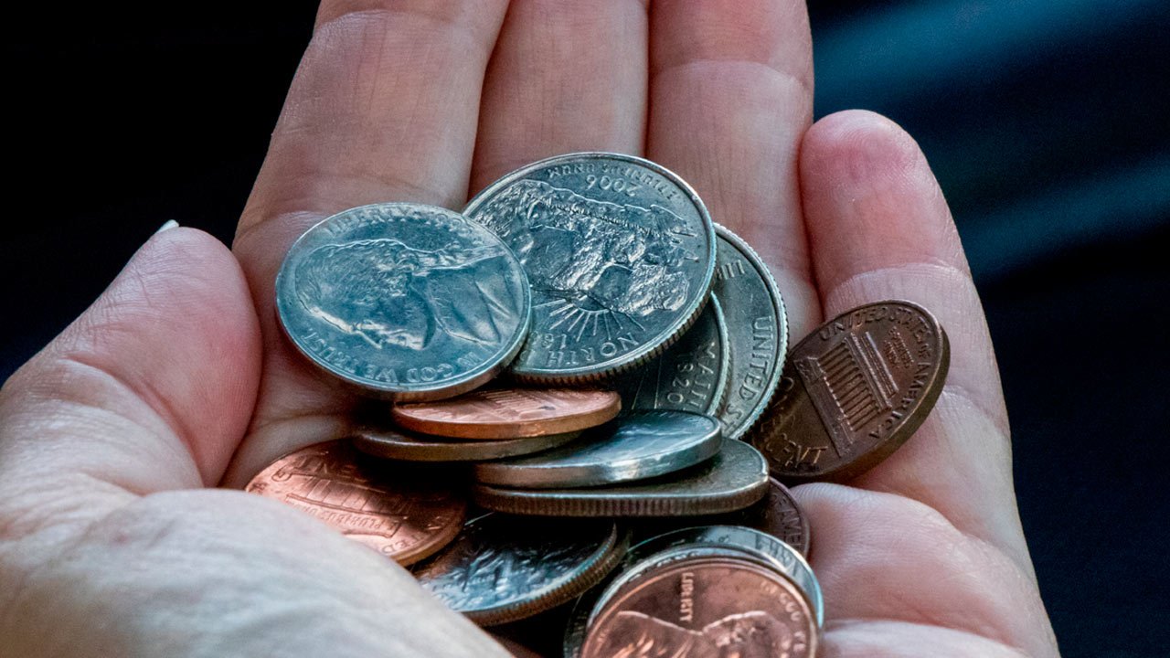
Coin Changing Problem

Slide 10
Coin Changing Problem
Target value = 50
coins[] = {10,5,20,25}
Possible Solutions
{coin * count}
{5 * 10} = 50 [10 coins]
{5 * 8 + 10 * 1} = 50 [9 coins].
{10 * 5} = 50 [5 coins]
{20 * 2 + 10 * 1} = 50 [3 coins]
{20 * 2 + 5 * 2} = 50 [4 coins]
{25 * 2} = 50 [2 coins]
… … ….
Best Solution
Two 25 coins. Total coins two.
25 * 2 = 50

Slide 11
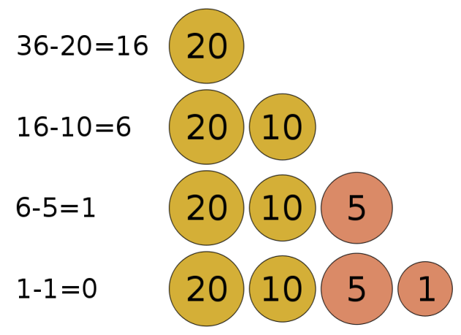
Coin Changing Problem
Target value n = 36
coins[] = {20,10,5,1}

Slide 12
Coin Changing Problem
Goal: Convert some amount of money n into given denominations, using the fewest possible number of coins
Input: An amount of money n, and an array of coins c = (c₁, c₂, …, c_{d})
Output: A list of d integers i₁, i₂, …, i_{d} such that c₁i₁ + c₂i₂ + … + c_{d}i_{d} = n
and i₁ + i₂ + … + i_{d} is minimal

Slide 13
Coin Changing Problem
Running time complexity including sorting = O(mlogm)+O(n)
Minimum Coin Change Problem Algorithm
1. Get coin array and a value.
2. Make sure that the array is sorted (descending order).
3. Take coin[i] as much we can.
4. Increment the count.
5. If solution found,
break it.
6. Otherwise,
follow step 3 with the next coin. coin[i+1].
4. Finally, print the count.

Slide 14
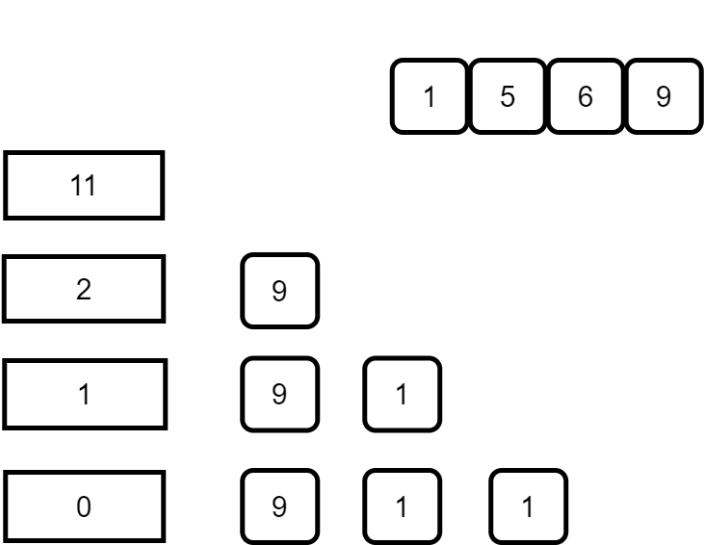
Issue with Greedy Algorithm Approach
While the coin change problem can be solved using Greedy algorithm, there are scenarios in which it does not produce an optimal result.

Slide 15
Issue with Greedy Algorithm Approach
Here, accordingly to the Greedy algorithm, we will end up the denomination 9, 1, 1 i.e. 3 coins to reach the value of 11. However, if you look closely, there is a more optimal solution. And that is by using the denominations 5 & 6. Using them, we can reach 11 with only 2 coins.
However, the way greedy approach works, this solution was never considered. And this can be thought of as a shortcoming of greedy approach. It does not work in the general cases.

Slide 16
Basics of Greedy Algorithms Related problem List:
https://www.hackerearth.com/practice/algorithms/greedy/basics-of-greedy-algorithms/practice-problems/
https://www.hackerrank.com/domains/algorithms?filters%5Bsubdomains%5D%5B%5D=greedy

Slide 17

Thanks to All

